Slide 1


Terry Chen
2022/3/22

Slide 2

Outline
Executive Summary
Introduction
Methodology
Results
Conclusion
Appendix

Slide 3
Executive Summary
With data wrangling, we can first filter out the data we don’t need and do some feature engineer before we start to explore it.
With EDA and Interactive analytics, we can get basic correlations between variables, better understanding of data and easier for choosing features.
Predictive analysis results, most of the models have similar results, since the dataset is too small.

Slide 4
Introduction
SpaceX’s accomplishments include: Sending spacecraft to the International Space Station. Starlink, a satellite internet constellation providing satellite Internet access. Sending manned missions to Space.
One reason SpaceX can do this is the rocket launches are relatively inexpensive.
SpaceX advertises Falcon 9 rocket launches on its website with a cost of 62 million dollars; other providers cost upwards of 165 million dollars each, much of the savings is because SpaceX can reuse the first stage.
Therefore, if we can determine if the first stage will land, we can determine the cost of a launch.
What features determine the first stage will success (land) or not?

Slide 5

Section 1

Slide 6
Methodology
Executive Summary
Data collection methodology:
Describe how data was collected
Perform data wrangling
Describe how data was processed
Perform exploratory data analysis (EDA) using visualization and SQL
Perform interactive visual analytics using Folium and Plotly Dash
Perform predictive analysis using classification models
How to build, tune, evaluate classification models

Slide 7
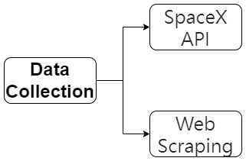
Data Collection
We collect data through:
SpaceX API
Web Scraping

Slide 8
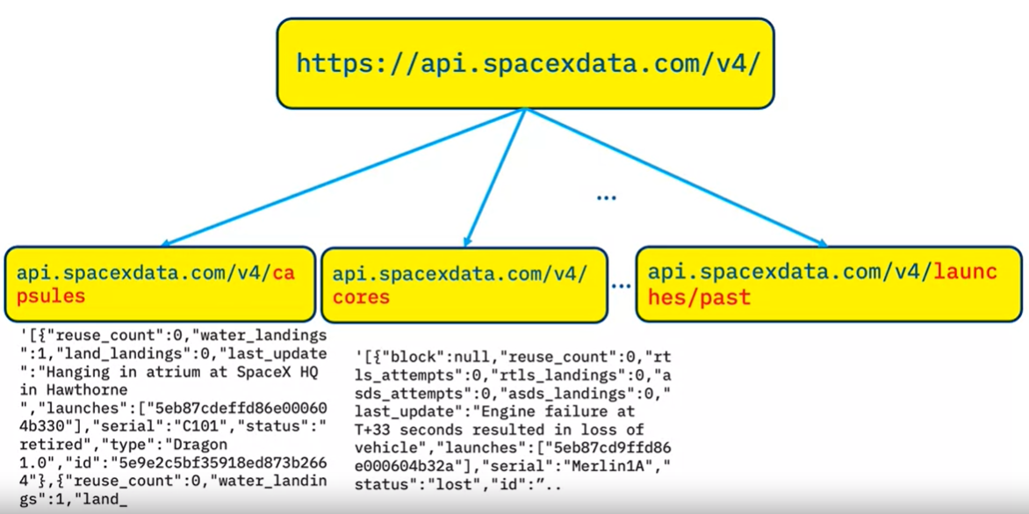
Data Collection – SpaceX API
The SpaceX REST API endpoints, or URL, starts with api.spacexdata.com/v4/, with different end points, for example: /capsules and /cores.
We will be working with the endpoint api.spacexdata.com/v4/launches/past.
View on GitHub

Slide 9
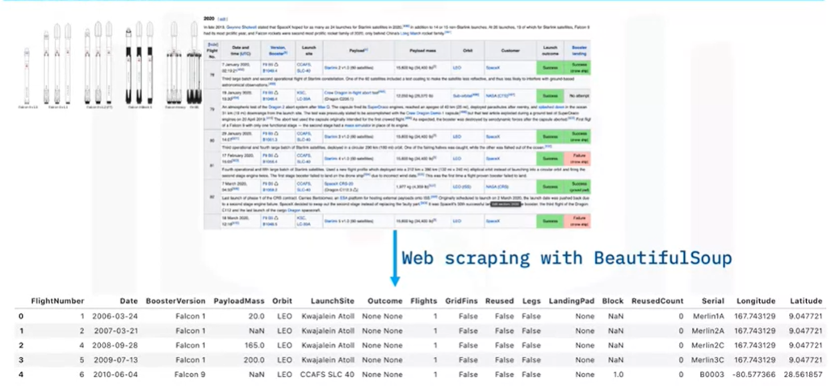
Data Collection - Scraping
Using the Python BeautifulSoup package to web scrape some HTML tables that contain valuable Falcon 9 launch records from Wiki pages.
View on GitHub

Slide 10
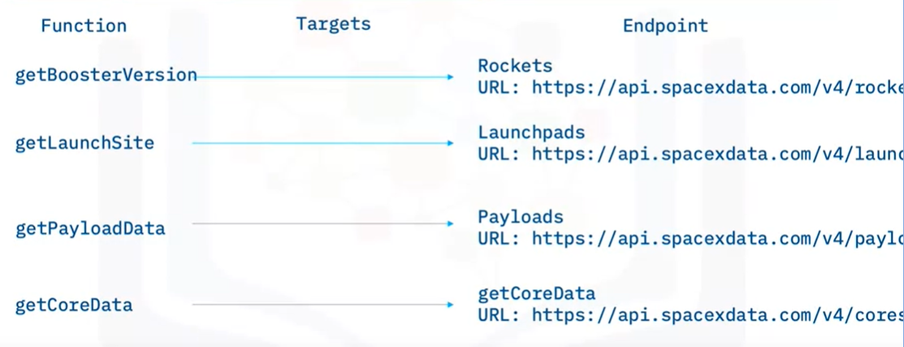
Data Wrangling
Wrangling data using API
Using the API again targeting another endpoint to gather specific data for each ID number.
Sampling data
Filtering/Sampling the data to remove Falcon 1 launches.
Dealing with Nulls
Replacing the NULL values inside the PayloadMass column by mean.
View on GitHub

Slide 11
EDA with Data Visualization
Scatter plot
For visualizing correlation between variables.
Bar plot
For visualizing success rate by category.
Line plot
For visualizing success rate by time.
View on GitHub

Slide 12
EDA with SQL
Using SQL queries to:
List the total number of successful and failure mission outcomes.
List the names of the booster_versions which have carried the maximum payload mass.
Rank the count of landing outcomes.
Etc.
View on GitHub

Slide 13
Build an Interactive Map with Folium
Using Interactive Map with Folium to:
Add each site's location on a map using site's latitude and longitude coordinates.
Mark the success/failed launches for each site on the map.
View on GitHub

Slide 14
Build a Dashboard with Plotly Dash
Pie chart
Visualizing the success rate.
Scatter plot
Visualizing the correlation between Payload Mass and success, with different Booster Version Category.
Interaction with Payload Mass and Launch Site
For easier to view results under different conditions.
View on GitHub

Slide 15
Predictive Analysis (Classification)
Using Logistic regression, KNN, Decision tree and SVM.
Doing GridsearchCV for hyperparameters tuning.
Evaluating performance with accuracy.
Viewing test set result by plotting confusion matrix.
View on GitHub

Slide 16
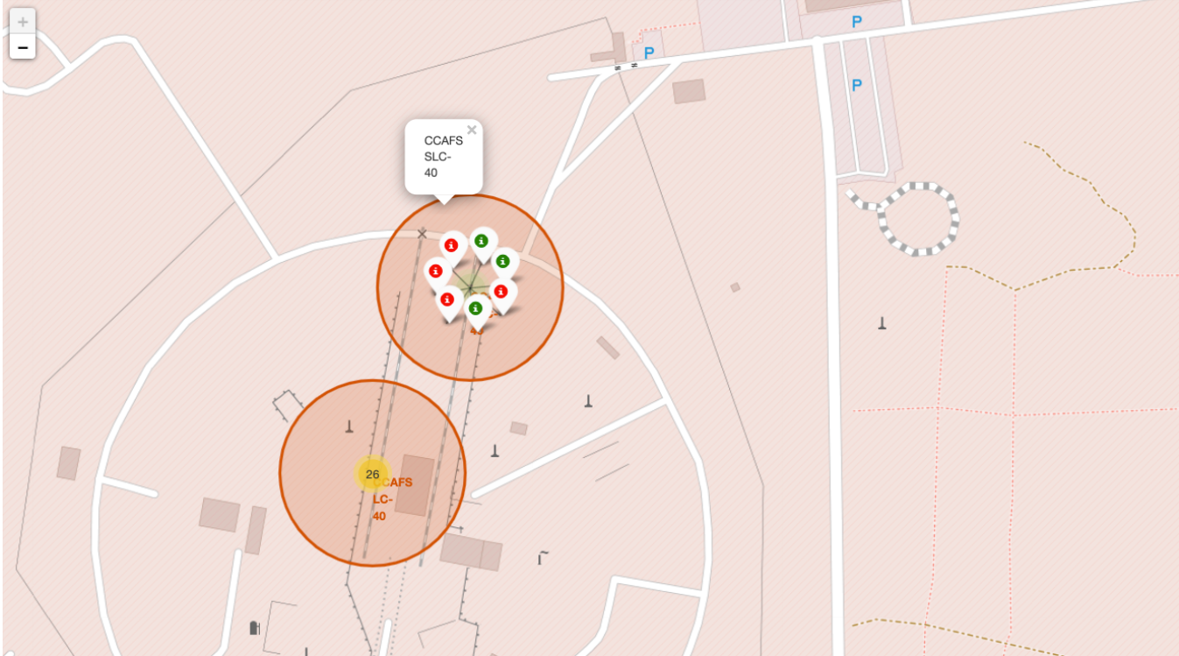
Results
EDA results:
Basic correlations between variables, better understanding for choosing features.
Interactive analytics demo in screenshots:
Predictive analysis results:
Most of the models have similar results, since the dataset is too small.

Slide 17

Section 2

Slide 18
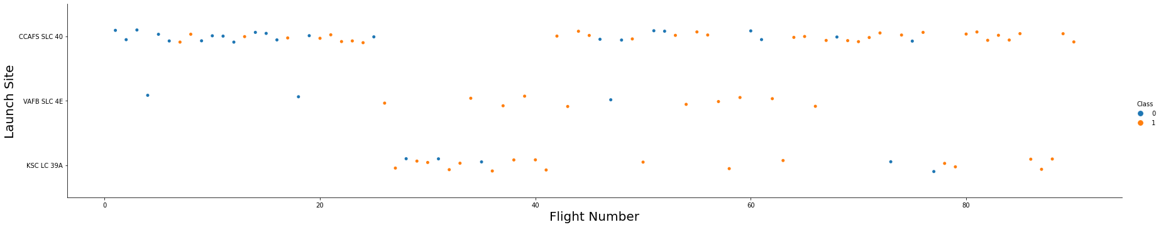
Flight Number vs. Launch Site
Observing Flight Number Vs. Launch Site scatter point chart you will find for most of the events occur at the CCAFS-SLC-40 launchsite after Flight Number greater than 40.

Slide 19
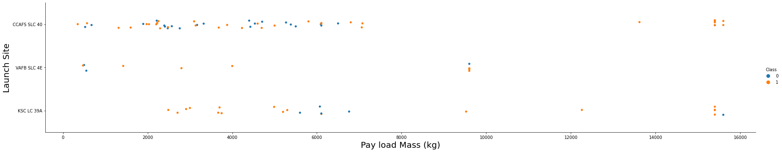
Payload vs. Launch Site
Observing Payload Vs. Launch Site scatter point chart you will find for the VAFB-SLC launchsite there are no rockets launched for heavypayload mass(greater than 10000).

Slide 20
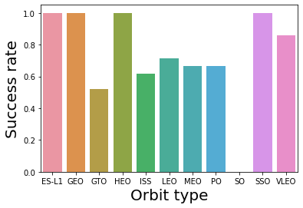
Success Rate vs. Orbit Type
SO has the success rate of 0%.
ES-L1, GEO, HEO and SSO have the success rate of 100%.

Slide 21
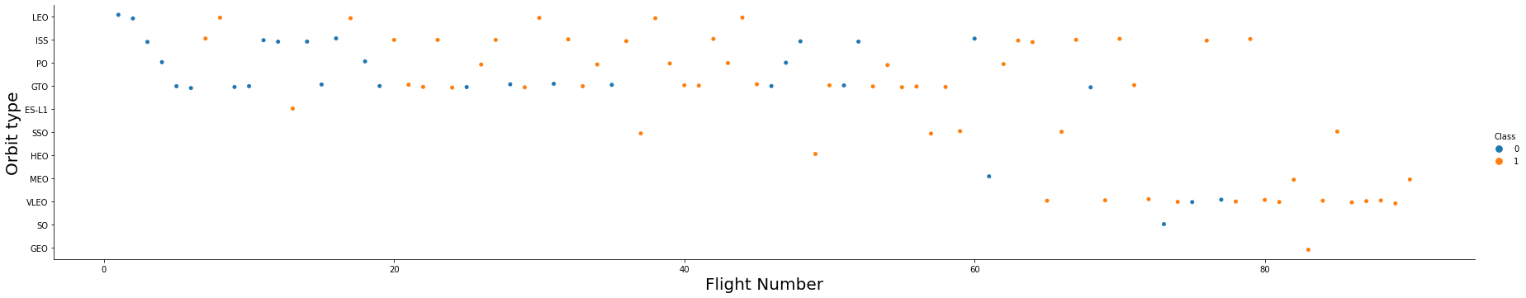
Flight Number vs. Orbit Type
In the LEO orbit the Success appears related to the number of flights; on the other hand, there seems to be no relationship between flight number when in GTO orbit.

Slide 22
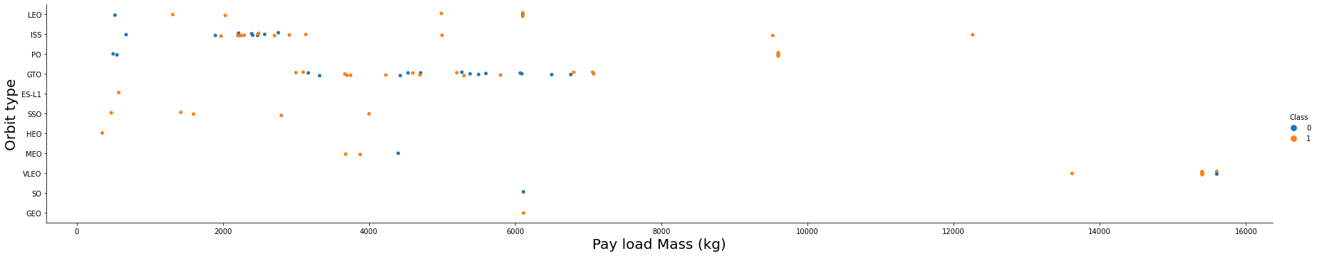
Payload vs. Orbit Type
With heavy payloads the successful landing or positive landing rate are more for Polar,LEO and ISS.
However for GTO we cannot distinguish this well as both positive landing rate and negative landing(unsuccessful mission) are both there here.

Slide 23
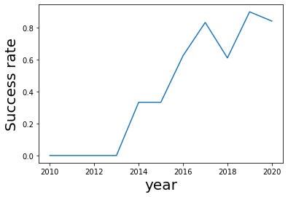
Launch Success Yearly Trend
The sucess rate since 2013 kept increasing till 2020.
A drop in 2018.

Slide 24
All Launch Site Names
There are 4 unique names for launch sites:
CCAFS LC-40
CCAFS SLC-40
KSC LC-39A
VAFB SLC-4E
Perhap the CCAFS LC-40 is typo of CCAFS SLC-40, or the old name of it.

Slide 25
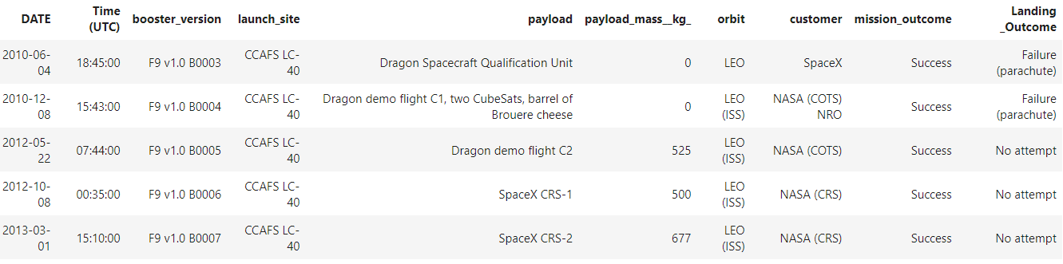
Launch Site Names Begin with 'CCA'
Landing outcomes were all fail with the first five records.

Slide 26
Payload Mass Calculation
Total Payload Mass
Total payload carried by boosters from NASA is 45596.
Average Payload Mass by F9 v1.1
Average payload mass carried by booster version F9 v1.1 is 2928.

Slide 27
First Successful Ground Landing Date
The date first successful landing outcome on ground pad is 2015-12-22.
5 years after the first attempt at 2010-04-06.

Slide 28
Successful Drone Ship Landing with Payload between 4000 and 6000
The names of boosters which have successfully landed on drone ship and had payload mass greater than 4000 but less than 6000
F9 FT B1022
F9 FT B1026
F9 FT B1021.2
F9 FT B1031.2

Slide 29
Total Number of Successful and Failure Mission Outcomes
Total number of successful and failure mission outcomes:
Failure (in flight): 1
Success: 99
Success (payload status unclear): 1

Slide 30
Boosters Carried Maximum Payload
The names of the booster which have carried the maximum payload mass with 15600 kg:
F9 B5 B1048.4
F9 B5 B1049.4
F9 B5 B1051.3
F9 B5 B1056.4
F9 B5 B1048.5
F9 B5 B1051.4
F9 B5 B1049.5
F9 B5 B1060.2
F9 B5 B1058.3
F9 B5 B1051.6
F9 B5 B1060.3
F9 B5 B1049.7

Slide 31
2015 Launch Records
The failed landing_outcomes in drone ship, their booster versions, and launch site names for in year 2015
F9 v1.1 B1012, CCAFS LC-40
F9 v1.1 B1015, CCAFS LC-40

Slide 32
Rank Landing Outcomes Between 2010-06-04 and 2017-03-20
The count of landing outcomes (such as Failure (drone ship) or Success (ground pad)) between the date 2010-06-04 and 2017-03-20, in descending order
Landing _Outcome | event_count | RANK
No attempt | 10 | 1
Failure (drone ship) | 5 | 2
Success (drone ship) | 5 | 2
Controlled (ocean) | 3 | 4
Success (ground pad) | 3 | 4
Failure (parachute) | 2 | 6
Uncontrolled (ocean) | 2 | 6
Precluded (drone ship) | 1 | 8

Slide 33

Section 3

Slide 34

Marking all launch sites
All launch sites in very close proximity to the coast.

Slide 35
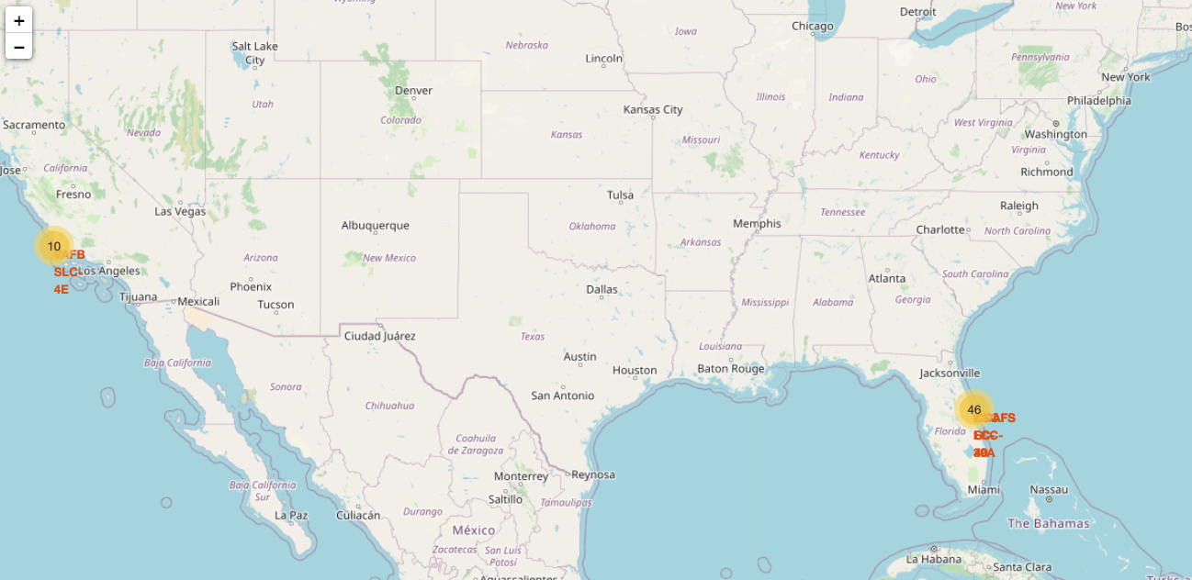
Marking the success/failed launches for each site
Most of the launches occur at Florida.

Slide 36

Section 4

Slide 37
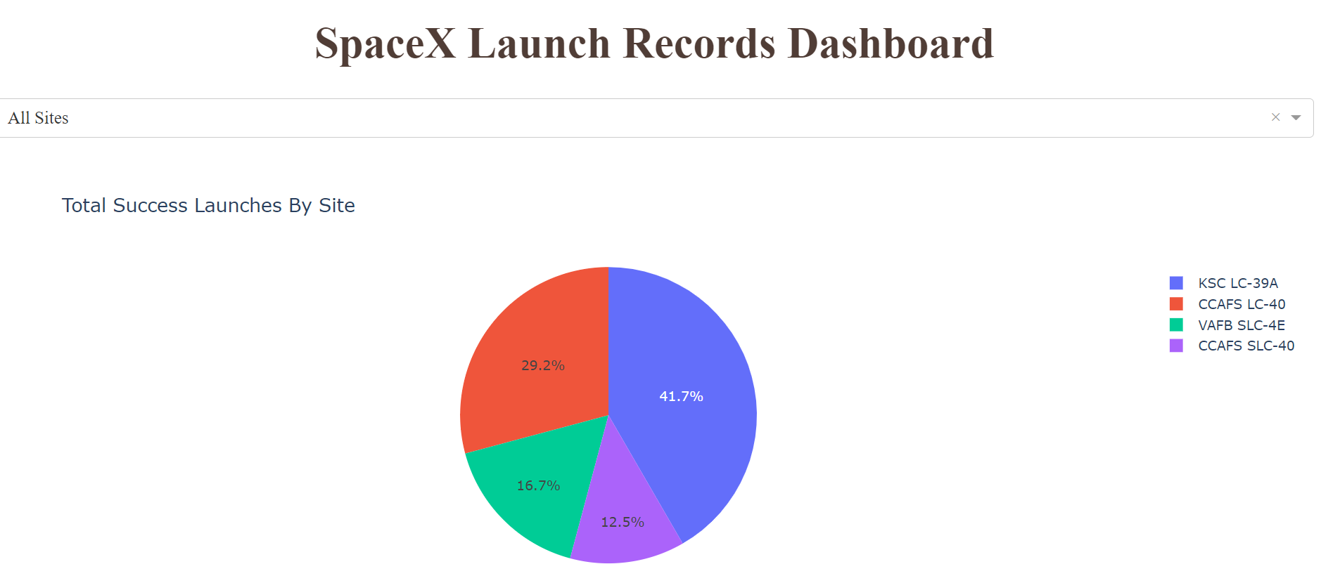
Pie chart for all sites
KSC-LC-39A has the most successful launch (41.7%).
Combining CCAFS-LC-40 and CCAFS-SLC-40 have the same successful launch.

Slide 38
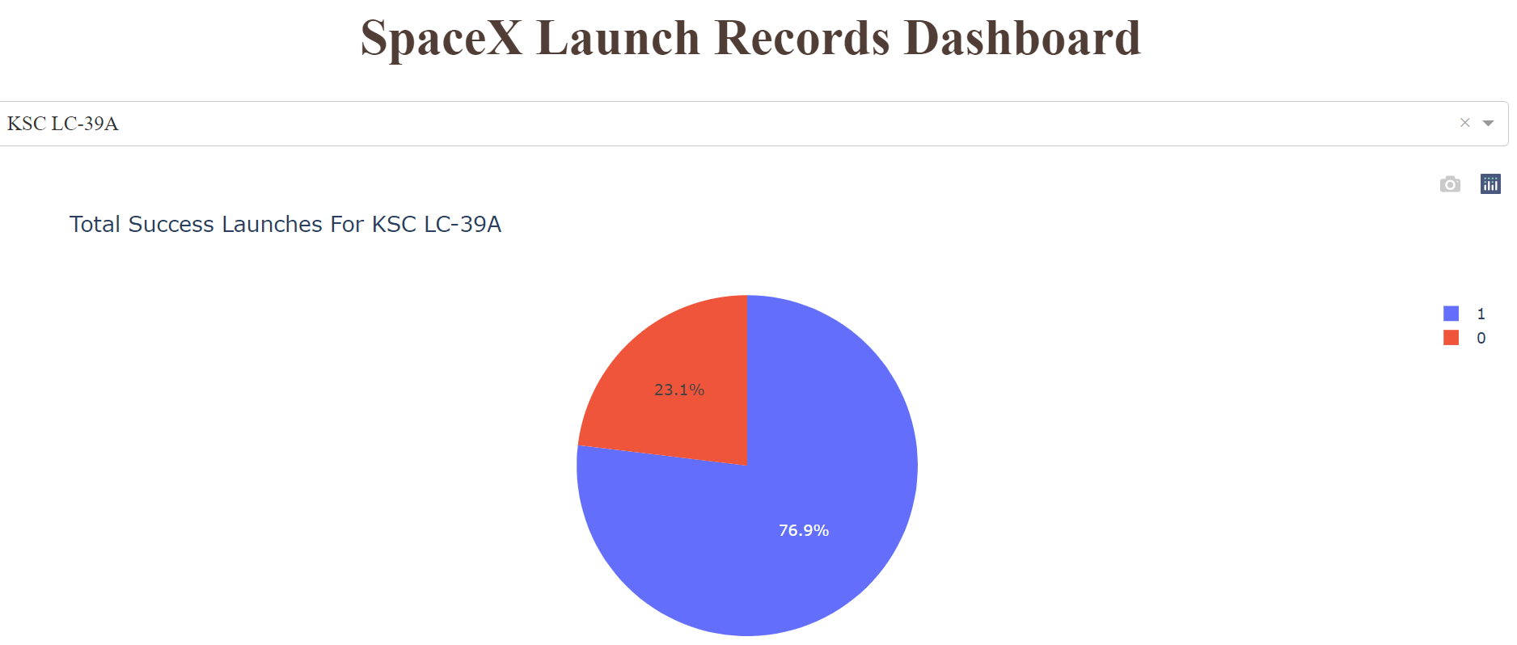
Pie chart for KSC-LC-39A
KSC-LC-39A has 76.9% success rate.

Slide 39
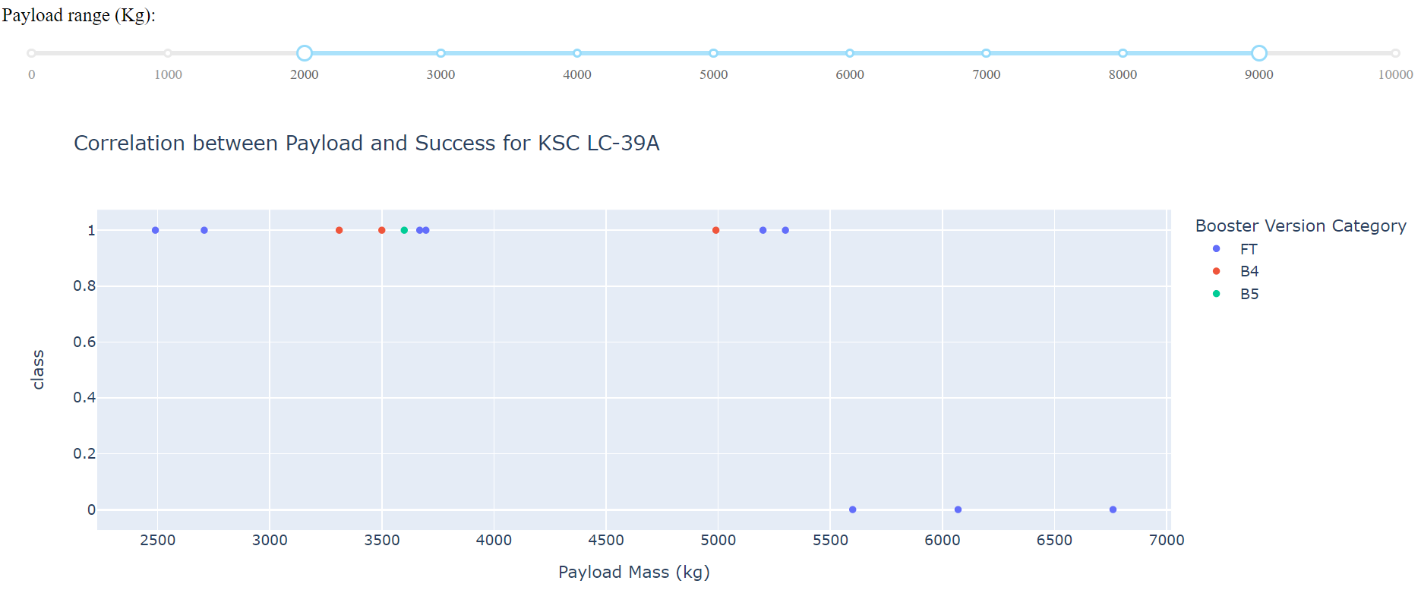
Scatter plot for KSC-LC-39A
All of the booster version are FT for Payload greater than 5000.
All of the outcome fails for Payload greater than 5500, success for Payload less than 5500.

Slide 40

Section 5

Slide 41

Classification Accuracy
Model | Train Accuracy | Test Accuracy
KNN | 0.848 | 0.833
SVM | 0.848 | 0.833
Decision tree | 0.889 | 0.778
Logistic regression | 0.846 | 0.833

Slide 42
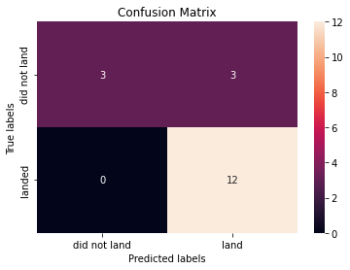
Confusion Matrix
Both KNN, Logistic regression and SVM got the same confusion matrix.
All of the models suffer from FP.

Slide 43
Conclusions
Decision tree is overfitted since high train accuracy with relative low test accuracy.
All of the model got similar results, since , since the dataset is too small.
In such small dataset, how the training set and test set split highly affect the final result.

Slide 44


